Slide 1

Object Oriented
Your success is our success
Funny Gorilla 诙猩猩
Notes:
Notes for title slide

Slide 2
Important Concepts
Object oriented programming (OOP)
Encapsulation
Inheritance
Composition
Polymorphism

Slide 3
Variable type vs Object type

Slide 5
Variable type vs Object type

Slide 6
Polymorphism
One reference type -> implemented by multiple object type
High level business logic is defined through interface(refence) type - framework
Up to each object type to execute its own business logic.

Slide 7
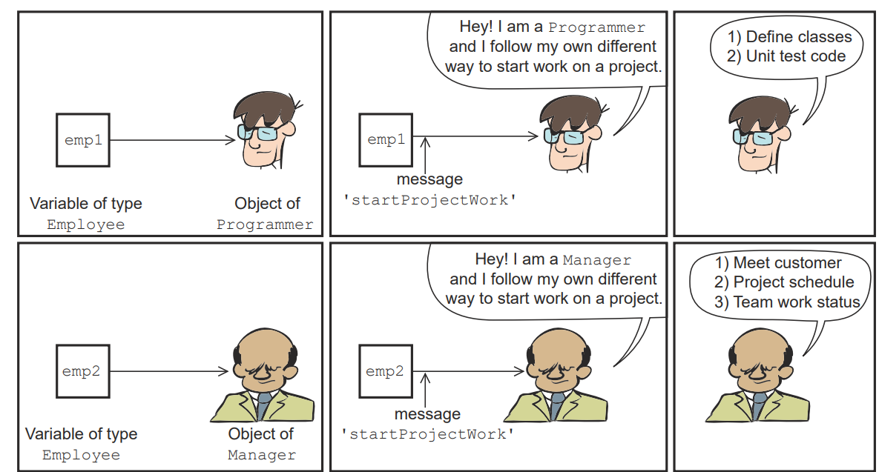
Variable type vs Object type

Slide 8
Programming to interface
Two OO programming principles
Favor composition over implementation

Slide 9
Reference
https://www.callicoder.com/java-arraylist/
https://introcs.cs.princeton.edu/java/31datatype/

Slide 10

Your success is our success
Contact
Mail: info@funnygorilla.com.au
Linkedin: https://mt.linkedin.com/in/songqing-gu-2ba9034b/de
Web Chat: FunnyGorilla
Phone: 0420891343

